Slide 1
Face Presentation attack Detection Using Deep Reinforcement Learning
Guide
Dr. R. Shyamala M.E..Phd.,AP/IT
Team members
Arulkumaran R (422419205003)
Jabaselvi A (422419205015)
Navieen R (422419205022)

Slide 2
Literature Survey
S. No | TITLE & AUTHOR | JOURNAL & YEAR | PROBLEM | SOLUTION | PARAMETER MEASURED | ADVANTAGES | DISADVANTAGES
1 | Salience- Aware Face Presentation Attack Detection via Deep Reinforcement Learning - Bingyao Yu, Jiwen Lu, Xiu Li, Jie Zhou. | IEEE TRANSACTIONS ON INFORMATION FORENSICS AND SECURITY, VOL. 17, 2022 | Face spoofing detection, replay attack, print attack detection.. | They propose SAFPAD approach, which takes advantage of DRL to exploit the salient local part information in face images. | Ablation Study, Cross- Dataset Testing, Salient Local Patches Number, Salient Local Patches Size | Usage of Reinforcement learning makes the FAS more efficient. | Needs to be improved in the generalization capability for the complicated face presentation attack detection,.
2 | DRL-FAS: A Novel Framework Based on Deep Reinforcement Learning for Face Anti- Spoofing - Rizhao Cai, Haoliang Li | IEEE TRANSACTIO NS ON INFORMATIO N FORENSICS AND SECURITY, VOL. 16, 2021 | Face spoofing detection, replay attack, detection.. | Reliable FAS techniques are highly desired and essential for developing secure face recognition systems. | We particularly employ a GRU to learn local features from f1, f2,... ft in a sequential and recursive manner. | We take advantage of RNN to memory information from all “observations” from sub-patches to reinforce extracted local features gradually. | The Computation of this FAS is slow due the usage of Recurrent Neural Network (RNN).
3 | Factors Related To The Improvement of Face Anti- Spoofing Detection Techniques With CNN Classifier - Ms. Sonali R. Chavan, Dr. Swati S. Sherekar, Dr. Vilas M. Thakre. | 2021 International Conference on Computational Intelligence and Computing Applications. | Face spoofing detection and replay attack detection. | This paper adopted comprehensive presentation of proposed Anti- spoofing techniques followed by features, datasets, parameters. | HTER, ACER, ACPER, BPCER, EER, EPR, FNR | CNN based algorithms approaches are most effective, depending on the type of spoof attack | Although many researchers have put their efforts to develop face detection systems but it fails to give adequate results in all situation.

Slide 3
S. No | TITLE & AUTHOR | JOURNAL & YEAR | PROBLEM | SOLUTION | PARAMETER MEASURED | ADVANTAGES | DISADVANTAGES
4 | Spoof Face Detection Via Semi- Supervised Adversarial Training - Chengwei Chen, Yaping Jing, Xuequan Lu. | 2022 International Joint Conference on Neural Networks (IJCNN) | 978- 1-7281-8671- 9/22/$31.00 ©2022 IEEE | DOI: 10.1109/IJCNN 55064.2022.989 275 | Face spoofing detection and print attack detection. | In this paper, we propose a semi- supervised adversarial learning framework for spoof face detection, which largely relaxes the supervision condition. | Weighting parameter, Adversarial loss, Image reconstruction loss, Maximum Mean Discrepancy. | Our approach does not need spoofing face data for training, and is thus semi-supervised and robust to different types of spoof faces. | The cross database experiments may cause errors in big scale.
5 | Face Anti- spoofing Based on Image Block Difference and Logistic Regression Analysis - | 2015 IEEE 5th International Conference on Consumer Electronics Berlin (ICCE- Berlin) | Face spoofing detection and replay attack detection. | The proposed method uses the difference between pairwise discrete cosine transform coefficients and logistic regression as a machine learning algorithm. | Feature extraction (HBD, VBD, HVBD), Scrambling. | The proposed anti- spoofing method is very simple, but the results of initial evaluations demonstrated its good performance on a slightly modified face anti- spoofing database. | The cross database experiments may cause errors in big scale.

Slide 4
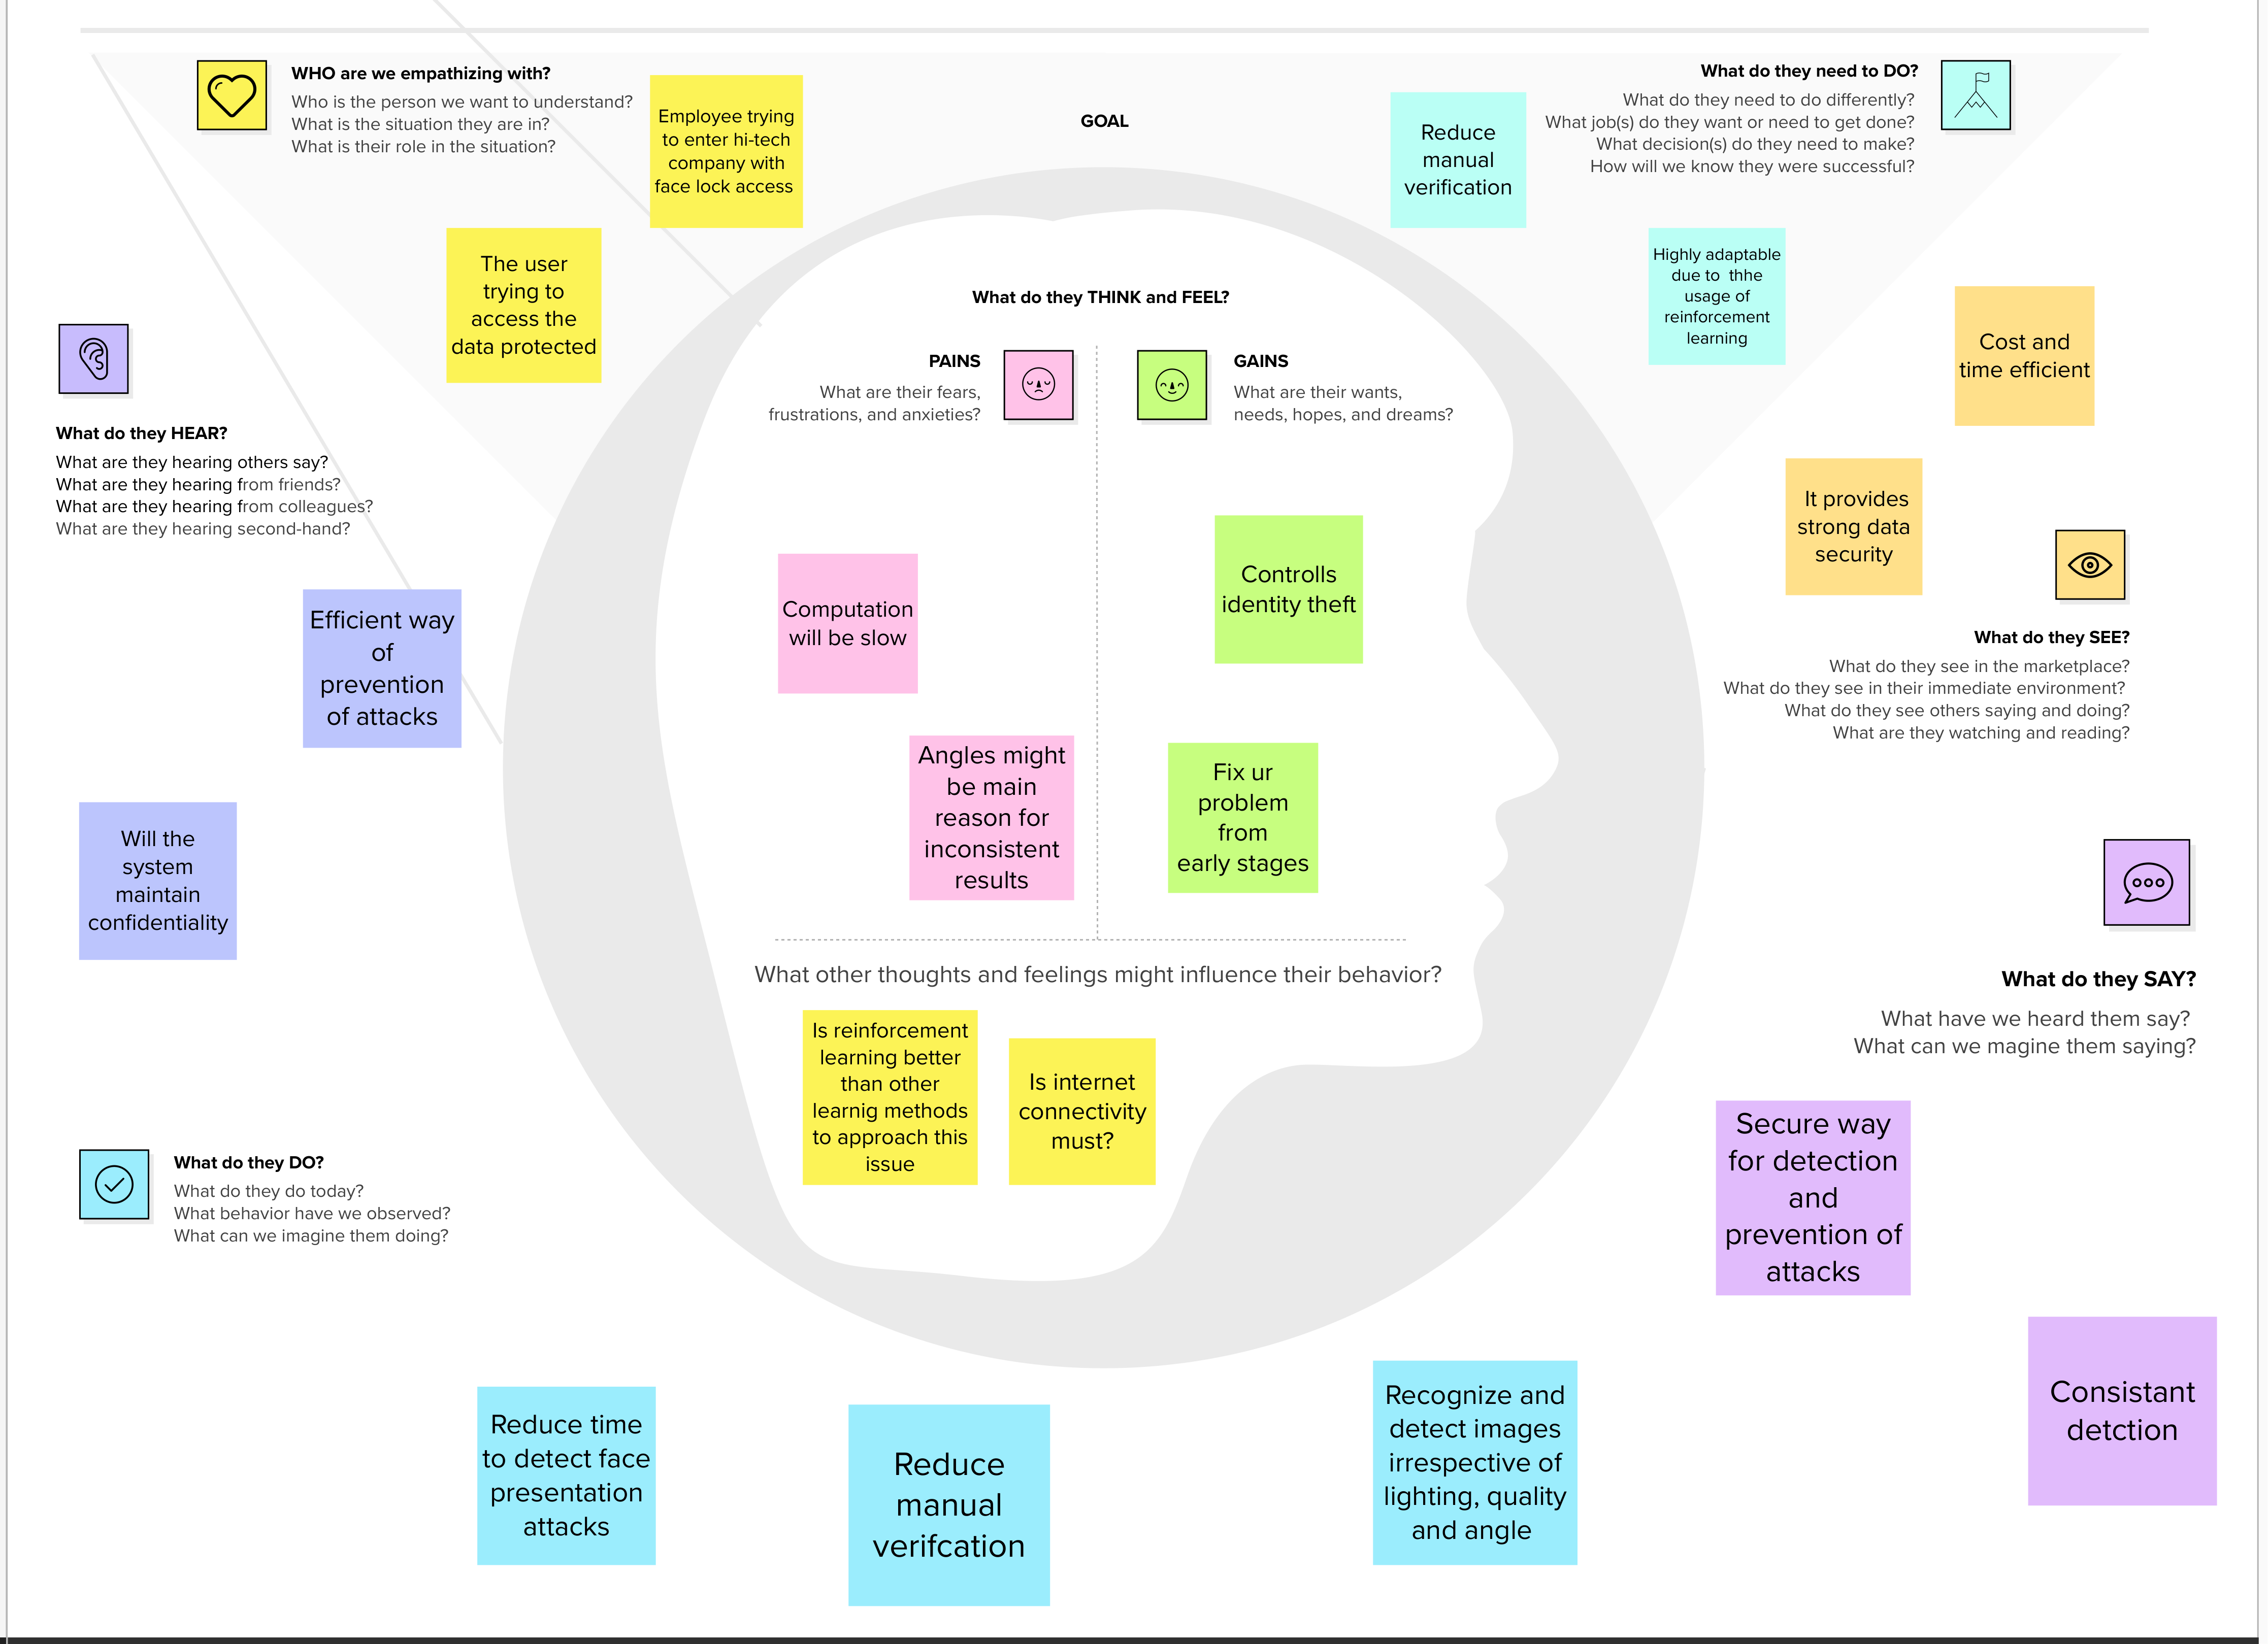
Empathy Map

Slide 5
Problem Statement
Mr. Walter White is a 45 year old successful businessman. He has a own business for past 20 years. In these 20 years he faced a lot of security issues and trouble in preventing the data from attackers.
Mr. Walter White wants to setup a face recognition system that prevents others from accessing his important data.
He has faced a huge loss for a long time.
He needs a secure face recognition system to prevent data from replay and print attacks.
He needs to secure his system immediately.
Who does the problem affect? | Person who has the data
What are the boundaries of the problem? | May lead to reputation loss and also leakage of models or prototypes.
What is the issue? | In business aspect, if confidential data gets released unknowingly of the user it may lead to huge financial loss.
When does the issue occur? | When attacker needs to access the data and corrupt the whole system.
Where does the issue occur? | The issue occurs in the system of the user.
Why is it important that we fix the problem? | It will be useless if the face recognition system is vulnerable to replay and print attacks. So it is important to detect and prevent these attacks.
What solution to solve this issue? | Improved face recognition system to correlate between real face and replay/print attack.
What methodology used to solve the issue? | We use deep reinforcement learning to prevent from attacks.

Slide 6
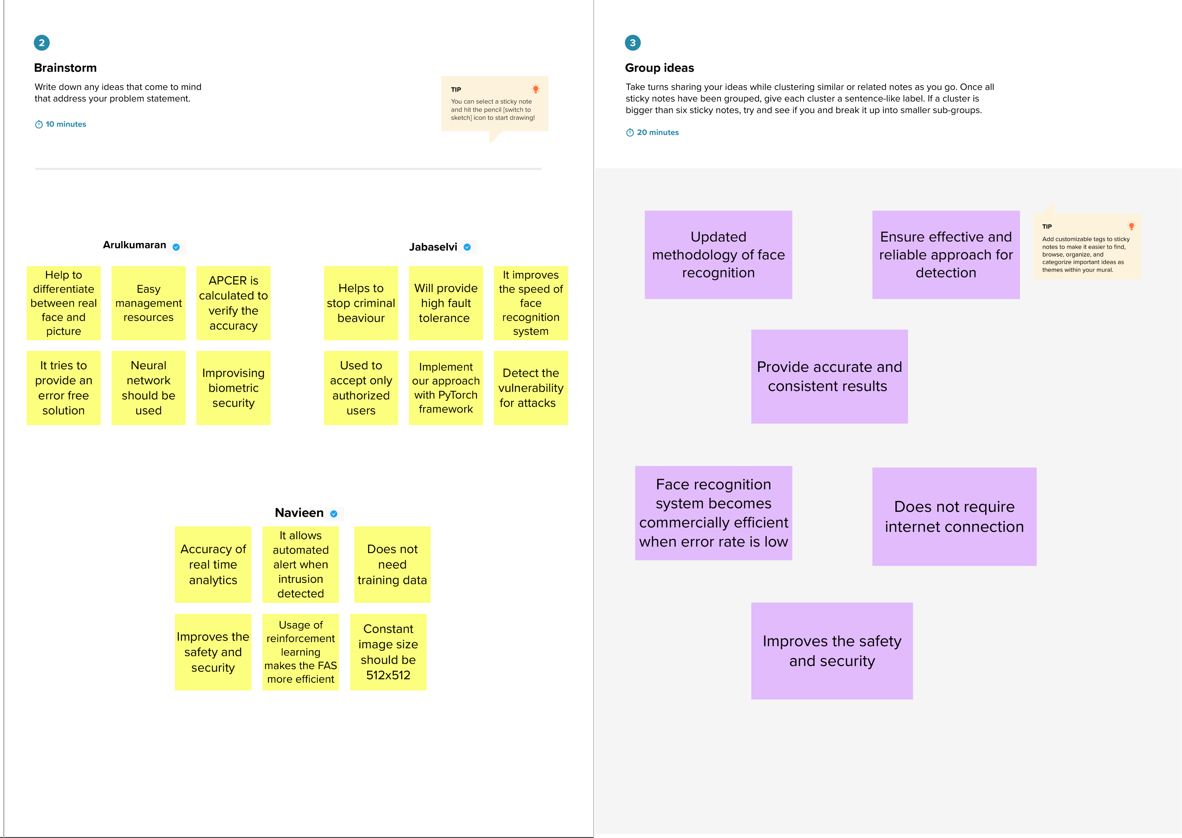
Brainstorming

Slide 7
